Slide 1
Heterogeneous Integration調査
富士通 岡本直哉

Slide 2
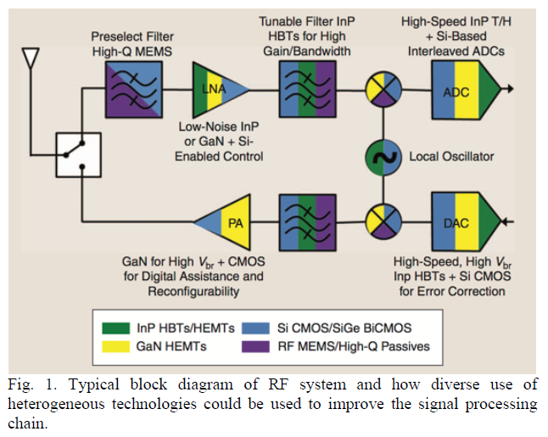
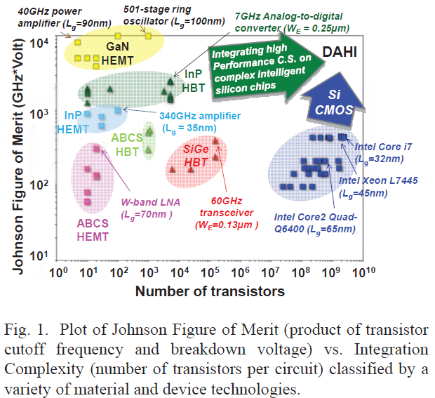
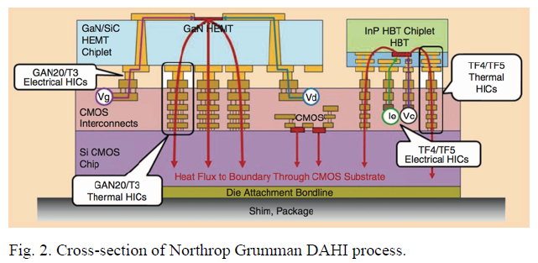
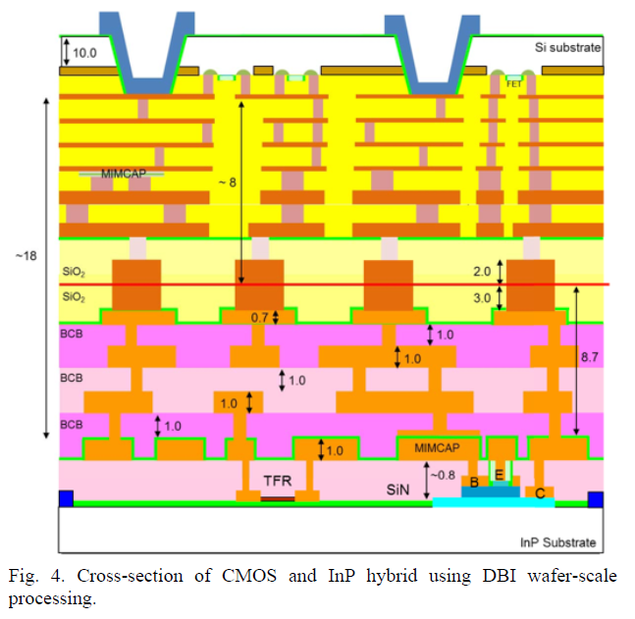
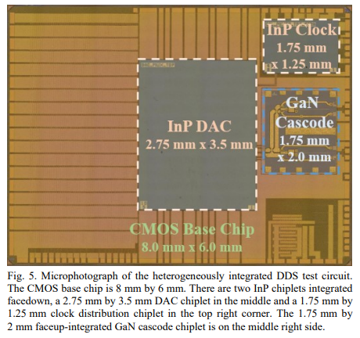
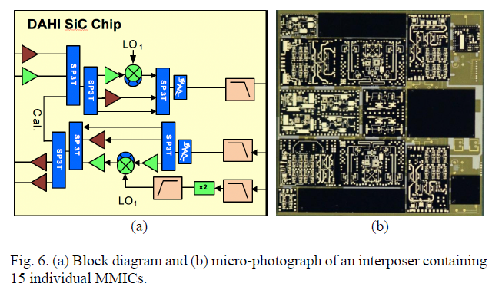
Heterogeneous Integration
2019, 2012
【DARPA】
DAHI（Diverse Accessible Heterogeneous Integration）, COSMOS（Compound Semiconductor Materials on Silicon）Program
・T. M. Hancock and J. C. Demmin, "Heterogeneous and 3D Integration at DARPA," 2019 International 3D Systems Integration Conference (3DIC), 2019, pp. 1-4, doi: https://doi.org/10.1109/3DIC48104.2019.9058884
・S. Raman, C. L. Dohrman and T. -H. Chang, "The DARPA Diverse Accessible Heterogeneous Integration (DAHI) program: Convergence of compound semiconductor devices and silicon-enabled architectures," 2012 IEEE International Symposium on Radio-Frequency Integration Technology (RFIT), 2012, pp. 1-6, doi: https://doi.org/10.1109/RFIT.2012.6401596
【Northrop Grumman】
【Teledyne】
【Northrop Grumman】
【BAE】
【HRL】

Slide 3
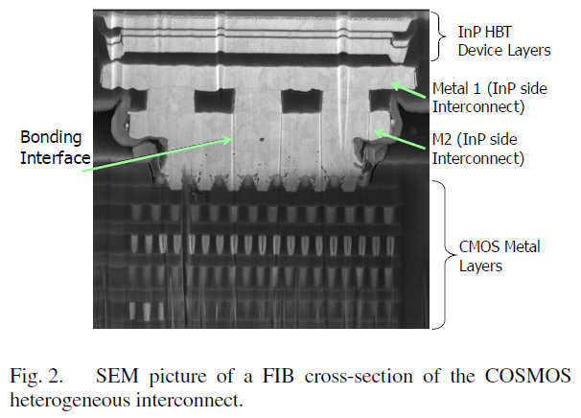
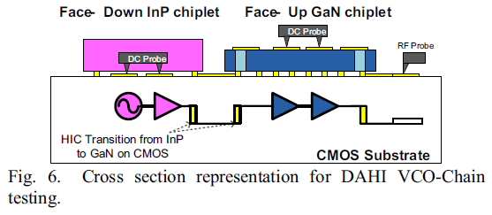
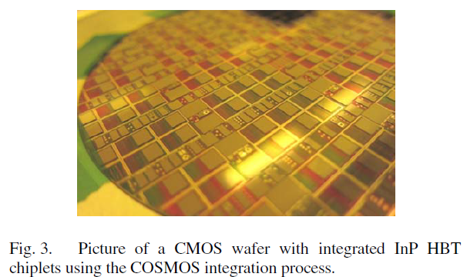
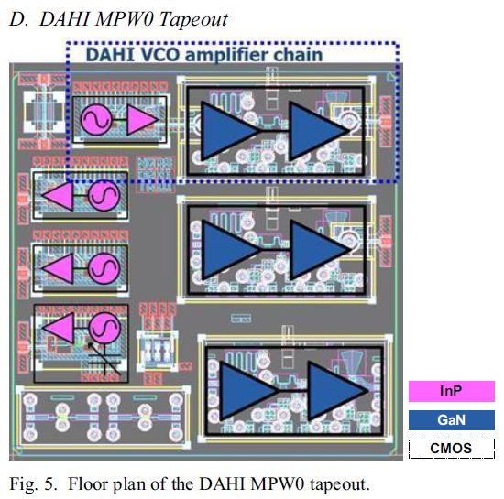
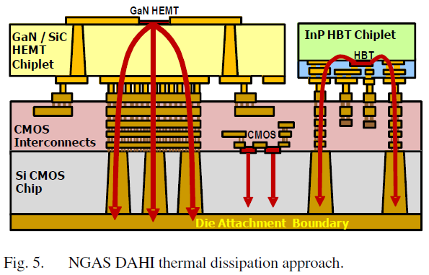
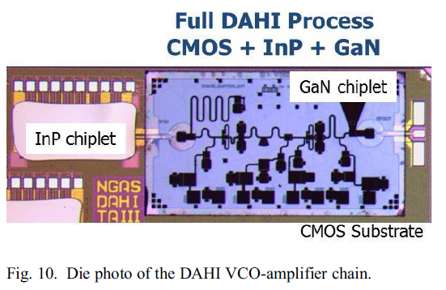
フリップチップタイプ
2014-2017
DARPA DAHI program
【Northrop Grumman】
・A. Gutierrez-Aitken et al., "A Meeting of Materials: Integrating Diverse Semiconductor Technologies for Improved Performance at Lower Cost," in IEEE Microwave Magazine, vol. 18, no. 2, pp. 60-73, March-April 2017, doi: https://doi.org/10.1109/10.1109/MMM.2016.2635838
・Y. -C. Wu, M. Watanabe and T. LaRocca, "InP HBT/GaN HEMT/Si CMOS heterogeneous integrated Q-band VCO-amplifier chain," 2015 IEEE Radio Frequency Integrated Circuits Symposium (RFIC), 2015, pp. 39-42, doi: https://doi.org/10.1109/10.1109/RFIC.2015.7337699
・V. Radisic et al., "Sub-millimeter wave InP technologies and integration techniques," 2015 IEEE MTT-S International Microwave Symposium, 2015, pp. 1-4, doi: https://doi.org/10.1109/MWSYM.2015.7167151
・A. Gutierrez-Aitken et al., "Diverse Accessible Heterogeneous Integration (DAHI) at Northrop Grumman Aerospace Systems (NGAS)," 2014 IEEE Compound Semiconductor Integrated Circuit Symposium (CSICS), 2014, pp. 1-4, doi: https://doi.org/10.1109/CSICS.2014.6978550
Keywords: MMIC, sub-millimeter wave, CMOS, HBT, HEMT, Heterogeneous integration, InP VCO, GaN amplifier, frequency synthesizer
Heterogeneous interconnectとCMOS上のInP HBT VCO, GaN PAの報告

Slide 4
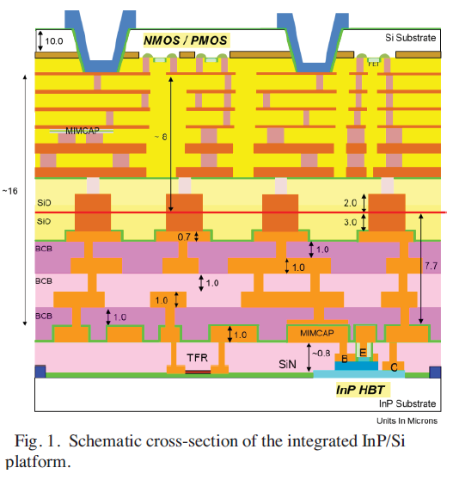
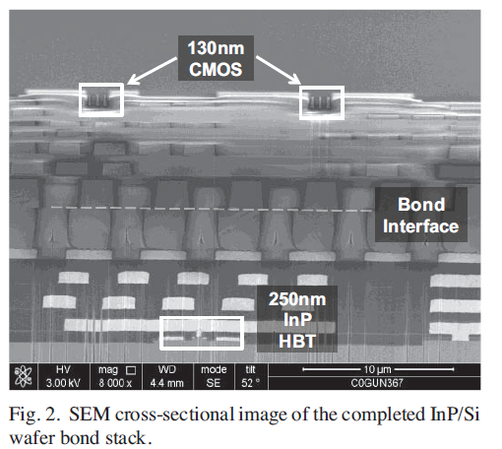
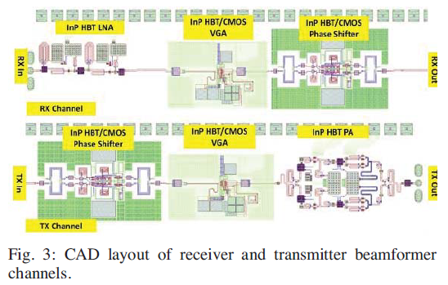
ウェハ接合タイプ
2016-2018
DARPA DAHI program
【Teledyne】その他
・A. D. Carter et al., "Si/InP Heterogeneous Integration Techniques from the Wafer-Scale (Hybrid Wafer Bonding) to the Discrete Transistor (Micro-Transfer Printing)," 2018 IEEE SOI-3D-Subthreshold Microelectronics Technology Unified Conference (S3S), 2018, pp. 1-4, doi: https://doi.org/10.1109/S3S.2018.8640196
・A. D. Carter et al., "Q-band InP/CMOS receiver and transmitter beamformer channels fabricated by 3D heterogeneous integration," 2017 IEEE MTT-S International Microwave Symposium (IMS), 2017, pp. 1760-1763, doi: https://doi.org/10.1109/MWSYM.2017.8058986
・ M. Urteaga et al., "THz bandwidth InP HBT technologies and heterogeneous integration with Si CMOS," 2016 IEEE Bipolar/BiCMOS Circuits and Technology Meeting (BCTM), 2016, pp. 35-41, doi: https://doi.org/10.1109/BCTM.2016.7738973
Ziptronix Direct Bond Interconnect (DBI®) process
Teledyne‘s 250nm InP HBT process with GlobalFoundries 130nm CMOS
Keywords: heterogeneous integration, hybrid wafer bonding, RF beamformer, CMOS, InP HBT, micro-transfer printing, terahertz
接合したCMOSのDC, InP HBTのFt,FmaxのデータやQ-band InP/CMOS receiver and transmitter beamformerの報告

Slide 5
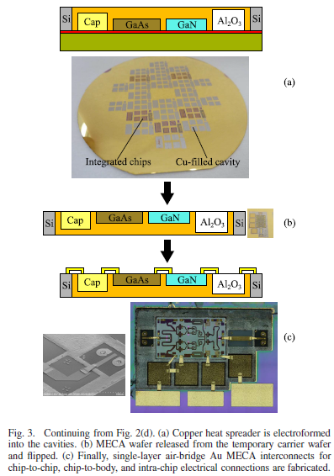
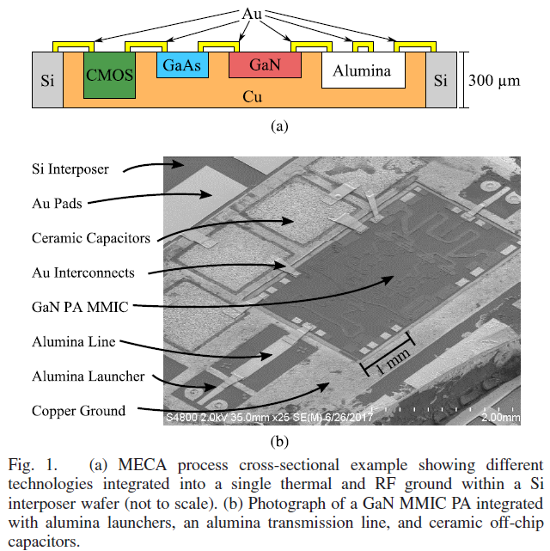
アッセンブリタイプ
2019
DARPA DAHI Program
University of Colorado at Boulder,【HRL】
・J. A. Estrada, G. Lasser, M. Pinto, F. Herrault and Z. Popović, "Metal-Embedded Chip Assembly Processing for Enhanced RF Circuit Performance," in IEEE Transactions on Microwave Theory and Techniques, vol. 67, no. 9, pp. 3537-3546, Sept. 2019, doi: https://doi.org/10.1109/TMTT.2019.2931010
metal-embedded chip assembly (MECA) process
Keywords: Couplers, GaN, heterogeneous integration, interconnects, multi-chip modules, power amplifiers (PAs), transmission lines.
アッセンブリした配線、GaN PA特性の報告

Slide 6
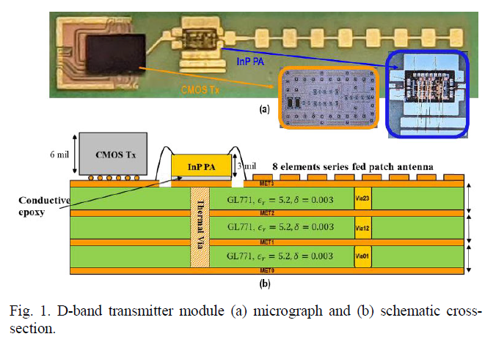
実装タイプ
2021, 2022
【UCSB】
・A. A. Farid, A. S. H. Ahmed and M. J. W. Rodwell, "A 27.5dBm EIRP D-Band Transmitter Module on a Ceramic Interposer," 2021 IEEE Radio Frequency Integrated Circuits Symposium (RFIC), 2021, pp. 43-46, doi: https://doi.org/10.1109/RFIC51843.2021.9490491
・A. A. Farid, A. S. H. Ahmed, A. Dhananjay and M. J. W. Rodwell, "A Fully Packaged 135-GHz Multiuser MIMO Transmitter Array Tile for Wireless Communications," in IEEE Transactions on Microwave Theory and Techniques, vol. 70, no. 7, pp. 3396-3405, July 2022, doi: https://doi.org/10.1109/TMTT.2022.3161972
Keywords: Heterogeneously integrated transmitters, D-band transmitter, D-band InP Power amplifiers, millimeter wave
packaging, Ceramic interposers, LTCC carrier, D-band antenna, massive multi-in–multi-out (MIMO) arrays, MIMO tiles, multiuser MIMO arrays.
セラミックインターポーザ上にD-band InP HBT PAとCMOS ICを搭載、伝送実験まで実施

Slide 7
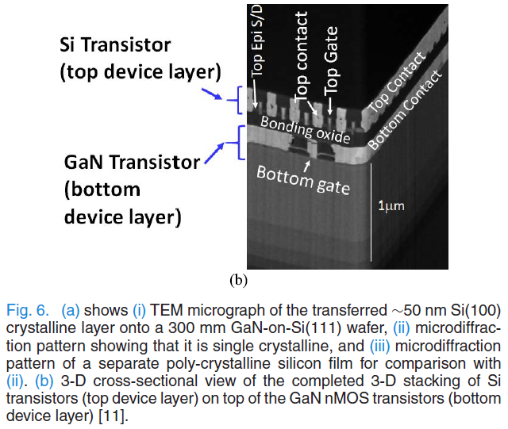
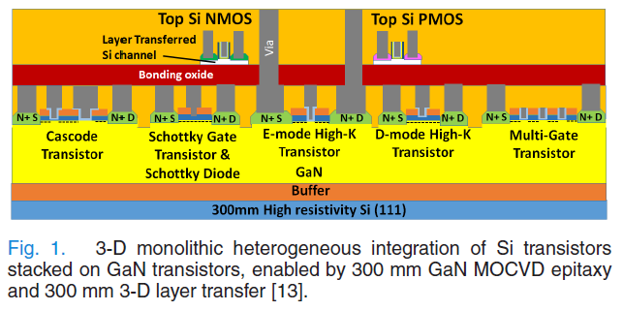
ウェハ接合タイプ
2019-2020
【Intel】
・H. W. Then et al., "Gallium Nitride and Silicon Transistors on 300 mm Silicon Wafers Enabled by 3-D Monolithic Heterogeneous Integration," in IEEE Transactions on Electron Devices, vol. 67, no. 12, pp. 5306-5314, Dec. 2020, doi: https://doi.org/10.1109/TED.2020.3034076
・H. Wui Then et al., "Advances in Research on 300mm Gallium Nitride-on-Si(111) NMOS Transistor and Silicon CMOS Integration," 2020 IEEE International Electron Devices Meeting (IEDM), 2020, pp. 27.3.1-27.3.4, doi: https://doi.org/10.1109/IEDM13553.2020.9371977
・H. W. Then et al., "3D heterogeneous integration of high performance high-K metal gate GaN NMOS and Si PMOS transistors on 300mm high-resistivity Si substrate for energy-efficient and compact power delivery, RF (5G and beyond) and SoC applications," 2019 IEEE International Electron Devices Meeting (IEDM), 2019, pp. 17.3.1-17.3.4, doi: https://doi.org/10.1109/IEDM19573.2019.8993583
Keywords: 300mmsilicon, 3-Dmonolithic integration, gallium nitride, high-k dielectric, silicon CMOS.
300mmSi基板上に作製したGaN NMOSと接合・剥離後に作製したSi PMOSのトランジスタ特性の報告

Slide 8
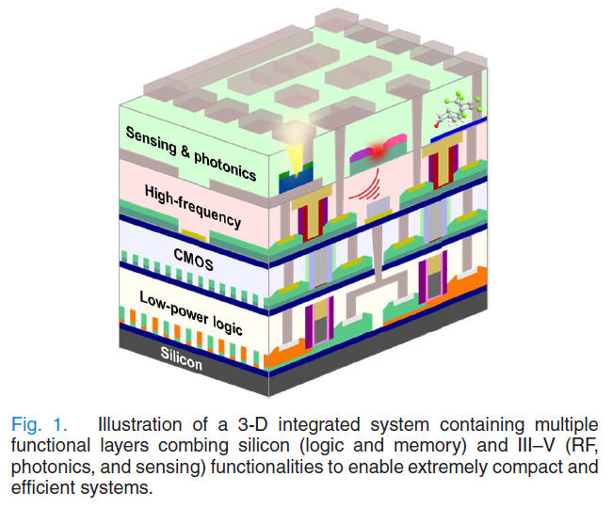
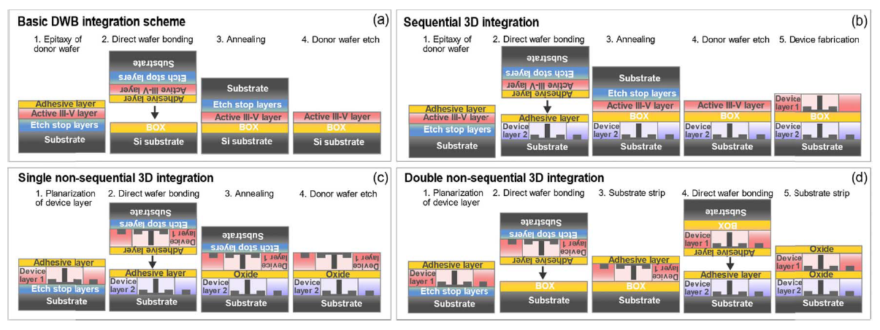
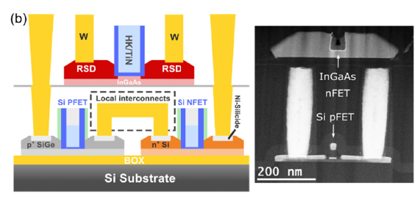
ウェハ接合タイプ
2021
【IBM】
・D. Caimi, P. Tiwari, M. Sousa, K. E. Moselund and C. B. Zota, "Heterogeneous Integration of III–V Materials by Direct Wafer Bonding for High-Performance Electronics and Optoelectronics," in IEEE Transactions on Electron Devices, vol. 68, no. 7, pp. 3149-3156, July 2021, doi: https://doi.org/10.1109/TED.2021.3067273
Direct wafer bonding(DWB)
Schematics of different heterogeneous integration schemes. (a) Basic integration by DWB, here showing the formation of a blank III–V-oninsulator film on a Si substrate. (b) Sequential 3-D integration results in an III–V device layer integrated on an already fabricated device layer, with high alignment accuracy between the two layers. (c) Single nonsequential 3-D integration, i.e., integration of two already fabricated device layers.
This approach yields a top layer that is flipped relative to the orientation of the original wafer. (d) By use of an intermediate transfer DWB step, the original orientation can be recovered in the final 3-D stack. This will allow for more straightforward interconnect formation between the layers.
Schematic of a 3-D integrated III–V MOSFET over Si CMOS stack, with a TEM image of the fabricated structure. These devices were integrated sequentially, yielding a high-accuracy alignment between the two layers.
Keywords：3-D integration, direct wafer bonding(DWB), III–V, MOSFET, optoelectronics, plasmonics, selective epitaxy
Al2O3を接合層としてウェハを直接接合したCMOS DC, InGaAs FinFETのDCとRF特性の報告

Slide 9
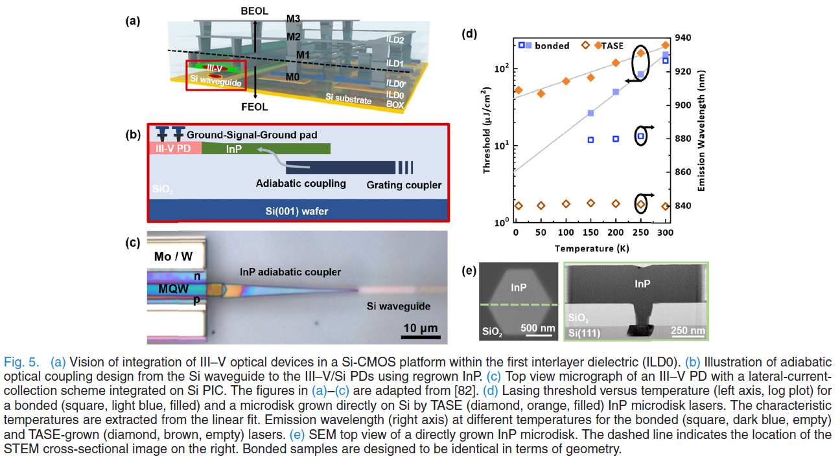
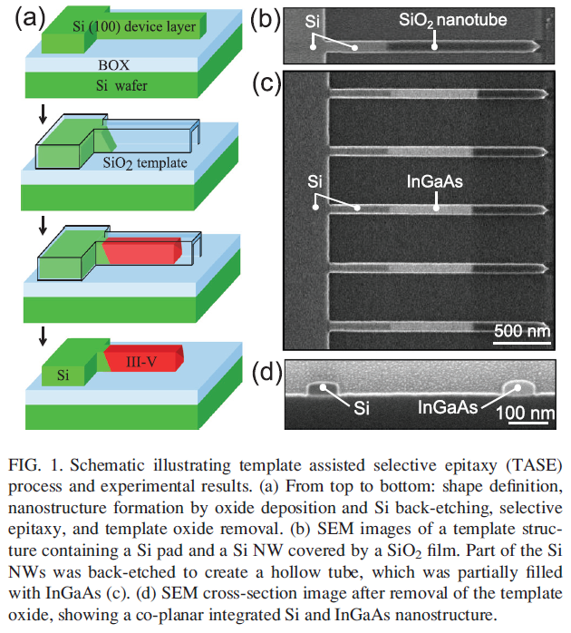
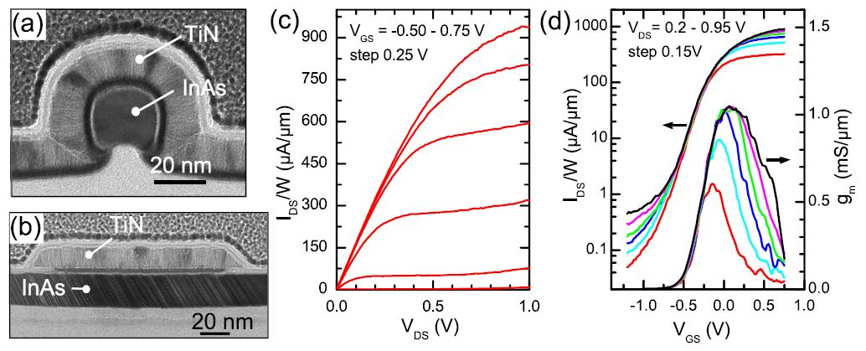
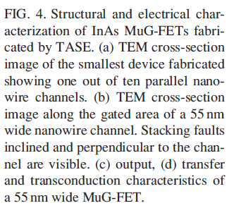
結晶成長タイプ
2015, 2021
【IBM】
・D. Caimi, P. Tiwari, M. Sousa, K. E. Moselund and C. B. Zota, "Heterogeneous Integration of III–V Materials by Direct Wafer Bonding for High-Performance Electronics and Optoelectronics," in IEEE Transactions on Electron Devices, vol. 68, no. 7, pp. 3149-3156, July 2021, doi: https://doi.org/10.1109/TED.2021.3067273
・H. Schmid, M. Borg, K. Moselund, L. Gignac, C. M. Breslin, J. Bruley, D. Cutaia, and H. Riel, ”Template-assisted selective epitaxy of III–V nanoscale devices for co-planar heterogeneous integration with Si”, Appl. Phys. Lett. 106, 233101 (2015); https://doi.org/10.1063/1.4921962
Template assisted selective epitaxy (TASE)
Keywords：3-D integration, direct wafer bonding(DWB), III–V, MOSFET, optoelectronics, plasmonics, selective epitaxy
Si基板上で横方向選択成長（TASE）したIII-Vの電子・光デバイスの報告

Slide 10
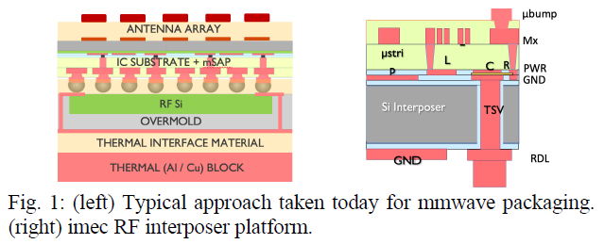
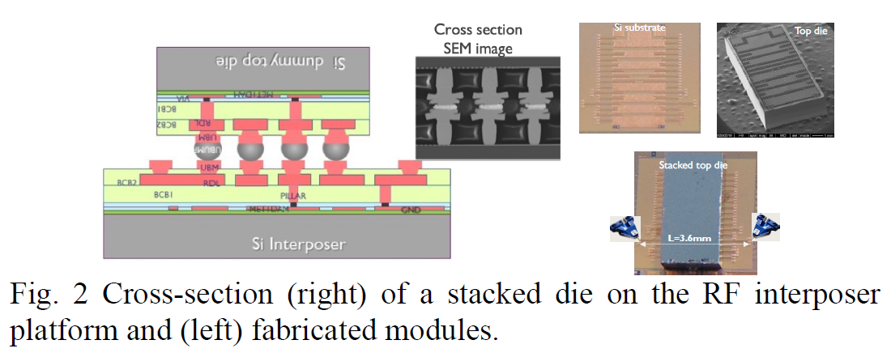
フリップチップタイプ
2022
【Imec】
・M. Peeters et al., "(Why do we need) Wireless Heterogeneous Integration (anyway?)," 2022 IEEE Symposium on VLSI Technology and Circuits (VLSI Technology and Circuits), 2022, pp. 256-257, doi: https://doi.org/10.1109/VLSITechnologyandCir46769.2022.9830480
・X. Sun et al., "Cost-effective RF interposer platform on low-resistivity Si enabling heterogeneous integration opportunities for beyond 5G," 2022 IEEE 72nd Electronic Components and Technology Conference (ECTC), 2022, pp. 7-11, doi: https://doi.org/10.1109/ECTC51906.2022.00009
Keywords: RF, mmwave, RF interposer, heterogeneous integration, beyond 5G, 6G, flipchip, RDL, InP, THz, D-band
Siインターポーザ上にダミーチップを搭載してマイクロストリップ配線の評価の報告

Slide 11
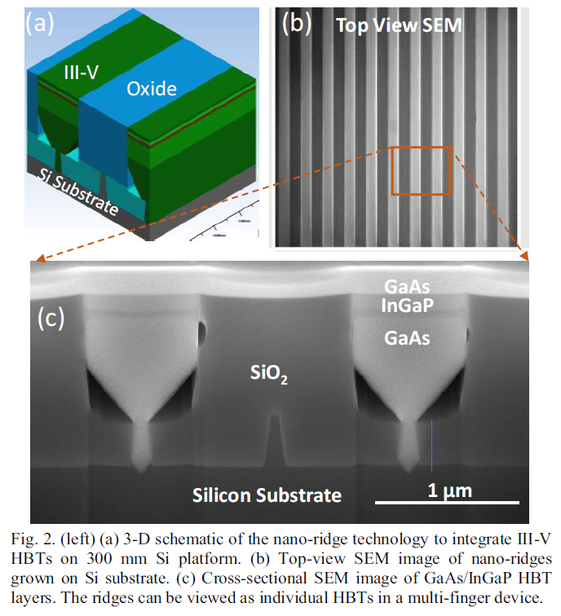
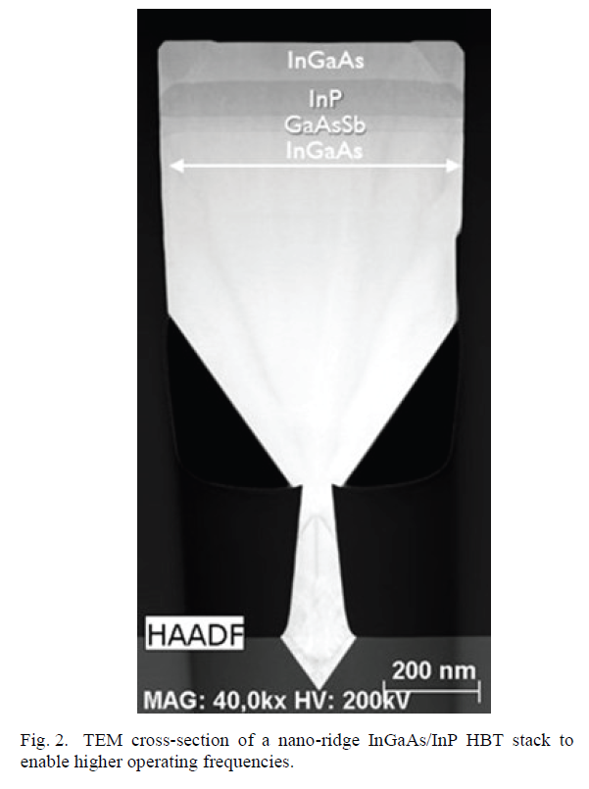
結晶成長タイプ
2022, 2020
【Imec】
・S. Yadav et al., "DC and RF Characterization of Nano-ridge HBT Technology Integrated on 300 mm Si Substrates," 2020 15th European Microwave Integrated Circuits Conference (EuMIC), 2021, pp. 89-92.
・N. Collaert, "Sub-THz III-V on Si technologies for 6G electronics," 2022 14th Global Symposium on Millimeter-Waves & Terahertz (GSMM), 2022, pp. 219-221, doi: https://doi.org/10.1109/GSMM53818.2022.9792338
Keywords：III-V HBTs on Si, 5G, heterogenous integration, III-V, HBT, 6G
Si基板の上に結晶成長したInGaP/GaAs HBTのDC, RF特性とInP/InGaAs HBT成長の報告

Slide 12
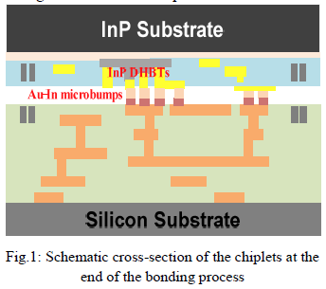
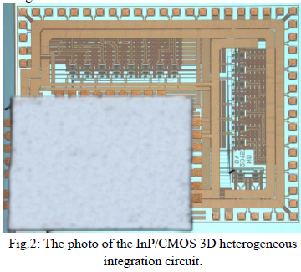
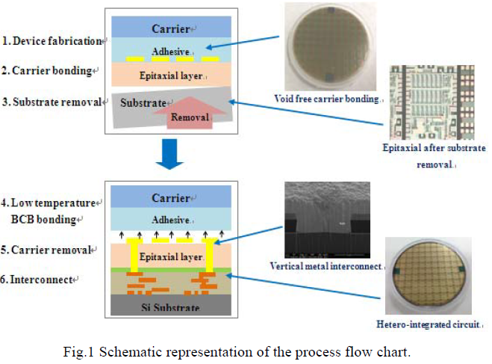
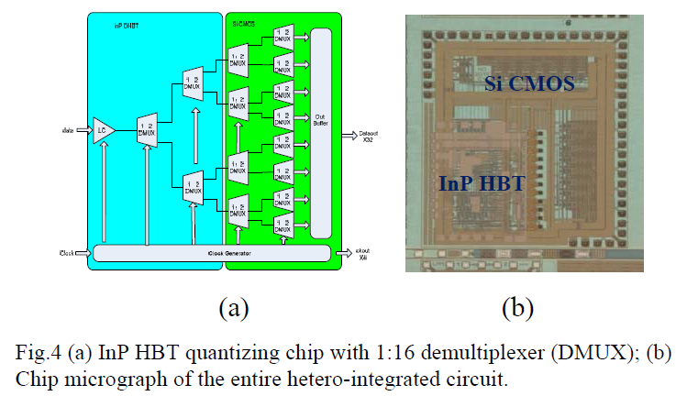
その他（中国）
2021, 2017
【Nanjing Electronic Devices Institute】
・L. Wu, J. Dai, C. Wei, Y. Kong, T. Chen and T. Zhang, "Heterogenous Integration of InP DHBT and Si CMOS by 30μm Pitch Au-In Microbumps," 2021 5th IEEE Electron Devices Technology & Manufacturing Conference (EDTM), 2021, pp. 1-3, doi: https://doi.org/10.1109/EDTM50988.2021.9420880
・L. Wu, Y. Kong, W. Cheng, Y. Zhang and T. Chen, "Heterogenous integration of III-V MMIC and Si CMOS," 2017 IEEE Electrical Design of Advanced Packaging and Systems Symposium (EDAPS), 2017, pp. 1-3, doi:
https://doi.org/10.1109/EDAPS.2017.8276907
Keywords: Si CMOS; III-V Compound semiconductor; heterogeneous integration; BCB
InP-on-Si CMOS 14Gbps 1:16 demultiplexer
InP HBT quantizing chip with 1:16 demultiplexer

Slide 13
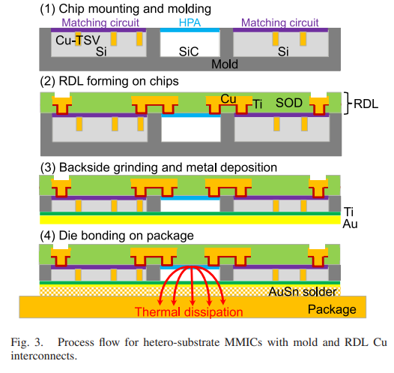
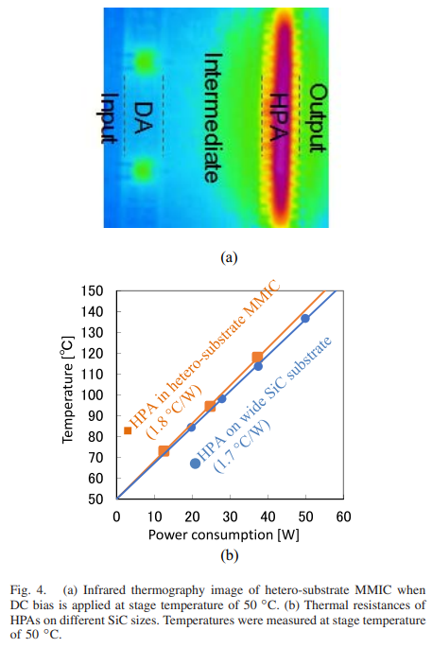
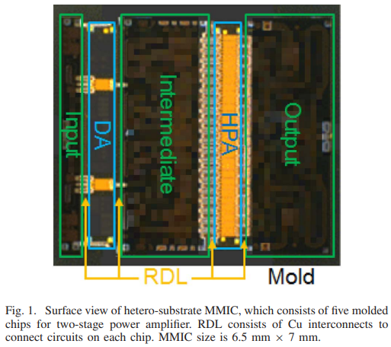
その他（日本）
【Fujitsu】
・M. Sato et al., "Heterogeneous Integration of Microwave GaN Power Amplifiers With Si Matching Circuits," in IEEE Transactions on Semiconductor Manufacturing, vol. 30, no. 4, pp. 450-455, Nov. 2017, doi: https://doi.org/10.1109/TSM.2017.2756823
Keywords: Compression molding, contact resistance, HEMTs, high power amplifiers, hybrid integrated circuits, impedance matching, integrated circuit interconnections, MIMICs, MMICs, loss measurement, soldering, thermal resistance, through-silicon vias
GaN PAチップとSi整合回路をモールド再配線にてハイブリッドIC作製、パワー特性評価の報告

