Slide 1
mmW Synthesizer Review (SiGe)
Ref. | Freq. (GHz) | Range (%) | Single/ Array | Output power (dBm) | EIRP (dBm) | P_{DC} (W) | DC-to-RF efficiency (%) | Phase noise (dBc/Hz) | Chip area (mm²) | On-chip ant. | Beam forming | Technology/ Country | Year | Other properties
[1] JSSC | 317 | n/a | Array | 5.2 | 22.5 | 0.61 | 0.54 | -79@1MHz | 2.1 | Yes(16)+Lens | No | 130-nm SiGe/USA | 2015 | PLL, Radiator
[2] JSSC | 932 | 2.5 | Array | -17.3 | -10 | 0.0057 | 3.3 | n/a | 0.37 | Yes(2) | No | 130-nm SiGe/USA | 2017 | Multiplier, Radiator
[3] JSSC | 1010 | n/a | Array | -10.9 | 13.1 | 1.1 | 0.0073 | n/a | 1 | Yes(91)+Lens | No | 130-nm SiGe/USA | 2018 | VCO, Radiator
[4] JSSC | 344 | 15.1 | Array | -6.8 | 4.9 | 0.45 | 0.046 | -93@1MHz | 1.2 | Yes(4) | Yes(2D) | 130-nm SiGe/USA | 2019 | VCO, Radiator
[5] JSSC | 150 | 28 | n/a | 2.2 | n/a | 0.1 | 1.7 | n/a | 0.08 | No | No | 130-nm SiGe/Germany | 2020 | Multiplier
 | 165 | 21.1 | n/a | -4 | n/a | 0.049 | 0.81 | n/a | 0.09 |  |  |  |  | IL-VCO
[6] ISSCC | 420 | n/a | Array | 9.2 | 32.8 | 4.5 | 0.19 | n/a | 12.6 | Yes(64)+Lens | No | 130-nm SiGe/Germany | 2020 | VCO, Radiator
[7] IMS | 270 | 18 | n/a | -5 | n/a | 0.125 | 0.25 | n/a | 0.4 | No | No | 130-nm SiGe/Germany | 2022 | Multiplier
[8] ISSCC | 425 | 14.6 | Array | -5.08 | 18.1 | 0.4 | 0.08 | -104@10MHz | 0.98 | Yes(6)+Lens | No | 90-nm SiGe/USA | 2022 | VCO, PIN-Diode, Radiator

Slide 2
mmW Synthesizer Review (CMOS)
Ref. | Freq. (GHz) | Range (%) | Single/ Array | Output power (dBm) | EIRP (dBm) | P_{DC} (W) | DC-to-RF efficiency (%) | Phase noise (dBc/Hz) | Chip area (mm²) | On-chip ant. | Beam forming | Technology/ Country | Year | Other properties
[9] ToTHz | 288 | 5.3 | Single | 0 | 10.2 | 0.284 | 0.34 | n/a | 0.49 | Yes(1) | No | 65-nm CMOS/Israel | 2015 | Multiplier, Radiator
[10] JSSC | 213 | 2.3 | n/a | -6.93 | n/a | 0.0034 | 6.02 | -93@1MHz | 0.0675 | No | No | 65-nm CMOS/USA | 2018 | VCO
[11] JSSC | 531.5 | 0.9 | Array | -12 | 2.3 | 0.26 | 0.024 | -98@1MHz | 2.5 | Yes(8) | Yes(2D) | 40-nm CMOS/Belgium | 2019 | ILO, Radiator
[12] TMTT | 280 | 4.11 | Array | 9 | 24.1 | 0.421 | 1.88 | n/a | 2.1 | Yes(30) | No | 65-nm CMOS/Israel | 2020 | VCO, Radiator
[13] JSSC | 459 | 8.9 | Array | -1.8 | 19.3 | 1.47 | 0.045 | -100.6@10MHz | 3.94 | Yes(25)+Lens | No | 65-nm CMOS/USA | 2020 | VCO, Radiator
[14] JSSC | 670 | 2.4 | Array | -16.1 | 7.4 | 0.1 | 0.025 | -69@1MHz | 0.86 | Yes(8)+Lens | No | 40-nm CMOS/Belgium | 2021 | VCO, Radiator
[15] JSSC | 414 | 5.3 | Single | -9 | 10 | 0.304 | 0.041 | n/a | 1.37 | Yes(1)+Lens | No | 40-nm CMOS/Belgium | 2021 | Multiplier, Radiator
[16] JSSC | 694 | 5.26 | Array | -3 | 27.3 | 0.754 | 0.066 | -73@1MHz | 0.97 | Yes(32)+Lens | No | 65-nm CMOS/China | 2022 | VCO, Radiator
[17] JSSC | 416 | 1.7 | Array | -3 | 14 | 1.45 | 0.034 | -88@1MHz | 4.1 | Yes(16) | Yes(3D) | 65-nm CMOS/USA | 2022 | VCO, Radiator
[18] JSSC | 450 | 4.6 | Array | -4.1 | 28.2 | 0.346 | 0.11 | -76.4@1MHz | 1.56 | Yes(16)+Lens | No | 65-nm CMOS/China | 2022 | VCO, Radiator
[19] ISSCC | 450 | 7 | Array | -21.6* | 3.6* | 0.095 | 0.0072 | n/a | 4 | Yes(21, 2)* +Lens | Yes(3D) | 65-nm CMOS/USA | 2021 | VCO, Radiator
*Only 2 elements active from the available 21

Slide 3
THz Synthesizer: Multiplier or VCO
Multiplier
Pros:
Noise
BW
Cons:
Area
Power Consumption
Sometimes need large power signal source
Scalability
VCO
Pros:
Power Consumption
Area
Self-drive
Scalability
Cons:
Noise
BW
Preferred for TRX, clean LO signal is needed
Preferred in most radiator publications, due to:
Noise is less important
Multiple VCO can self-drive, which will be combined by array and create larger radiated power
by Hans Herdian, Tokyo Institute of Technology

Slide 4
Scalability: Multiplier or VCO
Multiplier
VCO
Coupling
system
X
LO Ref
…
LO ref
X
X
…
X
.
.
.
.
.
.
.
.
.
Ref. signal is split to many, therefore: → need more buffer (area) → Stronger ref. signal (power)
Coupling system needed to sync. all VCOs.
Ref. signal only needs to connect to 1 VCO.
In radiator case, ref. signal can be eliminated.
by Hans Herdian, Tokyo Institute of Technology

Slide 5
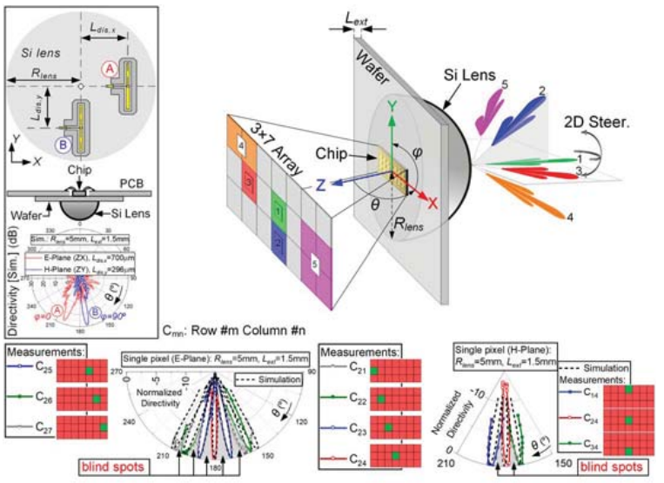
Beam-steering & Lens [19]
In most case, using lens increase directivity, but disables beam-steering capabilities.
Recently, this work [19] shows that beam-steering with lens is possible by utilizing array displacement from lens center.
Possible applications: Can receive/send multiple data stream to multiple target devices located in different directions.
Drawbacks: low EIRP because only 1-2 element can be utilized, instead of the whole 21 elements.
by Hans Herdian, Tokyo Institute of Technology

Slide 6
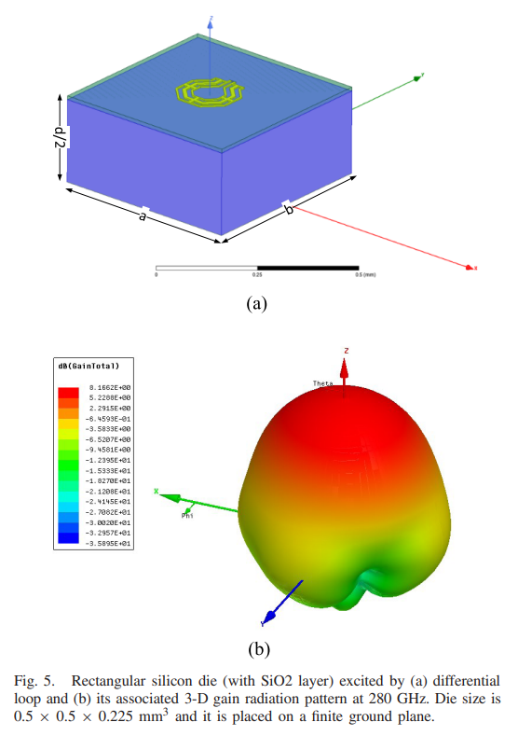
Dielectric Resonant Antenna (DRA) [12]
At sub-THz, dielectric with certain dimension can resonate in certain modes.
Rather than make the metal as antenna, use metal-element to excite the dielectric, and make the dielectric radiates.
Possible application for more efficient on-chip antenna and transition.
by Hans Herdian, Tokyo Institute of Technology

Slide 7
100チップ試作時の製造コスト
No | Technology Node | JPY/mm² for 100chip試作 | JPY/mm² (量産時予想価格)
1 | TSMC 65nm MS RF | 576 374 | 5-10
2 | TSMC 40nm MS RF | 794 087 | 7-12
3 | IHP 130-nm SiGe:C Bipolar/Analog | 887 004 | 10-20
4 | GlobalFoundy SiGe 8XP BiCMOS 130-nm | 1 152 748 | 15-30
※12インチウェハで加工費10万円(1.6円/mm²)～程度(マスクコスト除く)
Source: Europractice Mini@IC Program 2022 https://europractice-ic.com/schedules-prices-2022/
Please consider relative price only

Slide 8
Reference
R. Han et al., "A SiGe Terahertz Heterodyne Imaging Transmitter With 3.3 mW Radiated Power and Fully-Integrated Phase-Locked Loop," in IEEE Journal of Solid-State Circuits, vol. 50, no. 12, pp. 2935-2947, Dec. 2015.
H. Aghasi, A. Cathelin and E. Afshari, "A 0.92-THz SiGe Power Radiator Based on a Nonlinear Theory for Harmonic Generation," in IEEE Journal of Solid-State Circuits, vol. 52, no. 2, pp. 406-422, Feb. 2017.
Z. Hu, M. Kaynak and R. Han, "High-Power Radiation at 1 THz in Silicon: A Fully Scalable Array Using a Multi-Functional Radiating Mesh Structure," in IEEE Journal of Solid-State Circuits, vol. 53, no. 5, pp. 1313-1327, May 2018.
H. Jalili and O. Momeni, "A 0.34-THz Wideband Wide-Angle 2-D Steering Phased Array in 0.13- μ m SiGe BiCMOS," in IEEE Journal of Solid-State Circuits, vol. 54, no. 9, pp. 2449-2461, Sept. 2019.
M. Kucharski, M. H. Eissa, A. Malignaggi, D. Wang, H. J. Ng and D. Kissinger, "D-Band Frequency Quadruplers in BiCMOS Technology," in IEEE Journal of Solid-State Circuits, vol. 53, no. 9, pp. 2465-2478, Sept. 2018.
R. Jain, P. Hillger, J. Grzyb and U. R. Pfeiffer, "29.1 A 0.42THz 9.2dBm 64-Pixel Source-Array SoC with Spatial Modulation Diversity for Computational Terahertz Imaging," 2020 IEEE International Solid- State Circuits Conference - (ISSCC), 2020, pp. 440-442.
A. Gadallah, M. H. Eissa, T. Mausolf, D. Kissinger and A. Malignaggi, "A 250-300 GHz Frequency Multiplier-by-8 Chain in SiGe Technology," 2022 IEEE/MTT-S International Microwave Symposium - IMS 2022, 2022, pp. 657-660.
S. Razavian and A. Babakhani, "A Highly Power Efficient 2×3 PIN-Diode-Based Intercoupled THz Radiating Array at 425GHz with 18.1dBm EIRP in 90nm SiGe BiCMOS," 2022 IEEE International Solid- State Circuits Conference (ISSCC), 2022, pp. 1-3.

Slide 9
Reference
S. Jameson and E. Socher, "A 0.3 THz Radiating Active ×27 Frequency Multiplier Chain With 1 mW Radiated Power in CMOS 65-nm," in IEEE Transactions on Terahertz Science and Technology, vol. 5, no. 4, pp. 645-648, July 2015.
H. Wang, J. Chen, J. T. S. Do, H. Rashtian and X. Liu, "High-Efficiency Millimeter-Wave Single-Ended and Differential Fundamental Oscillators in CMOS," in IEEE Journal of Solid-State Circuits, vol. 53, no. 8, pp. 2151-2163, Aug. 2018.
K. Guo, Y. Zhang and P. Reynaert, "A 0.53-THz Subharmonic Injection-Locked Phased Array With 63- μ W Radiated Power in 40-nm CMOS," in IEEE Journal of Solid-State Circuits, vol. 54, no. 2, pp. 380-391, Feb. 2019.
N. Buadana, S. Jameson and E. Socher, "A Multiport Chip-Scale Dielectric Resonator Antenna for CMOS THz Transmitters," in IEEE Transactions on Microwave Theory and Techniques, vol. 68, no. 9, pp. 3621-3632, Sept. 2020.
H. Jalili and O. Momeni, "A 0.46-THz 25-Element Scalable and Wideband Radiator Array With Optimized Lens Integration in 65-nm CMOS," in IEEE Journal of Solid-State Circuits, vol. 55, no. 9, pp. 2387-2400, Sept. 2020.
G. Guimarães and P. Reynaert, "A 670-GHz 4 × 2 Oscillator–Radiator Array Achieving 7.4-dBm EIRP in 40-nm CMOS," in IEEE Journal of Solid-State Circuits, vol. 56, no. 11, pp. 3399-3411, Nov. 2021.
D. Simic, K. Guo and P. Reynaert, "A 420-GHz Sub-5-μm Range Resolution TX–RX Phase Imaging System in 40-nm CMOS Technology," in IEEE Journal of Solid-State Circuits, vol. 56, no. 12, pp. 3827-3839, Dec. 2021.
L. Gao and C. H. Chan, "A 0.68–0.72-THz 2-D Scalable Radiator Array With − 3-dBm Radiated Power and 27.3-dBm EIRP in 65-nm CMOS," in IEEE Journal of Solid-State Circuits, 2022.
H. Saeidi, S. Venkatesh, C. R. Chappidi, T. Sharma, C. Zhu and K. Sengupta, "A 4×4 Steerable 14-dBm EIRP Array on CMOS at 0.41 THz With a 2-D Distributed Oscillator Network," in IEEE Journal of Solid-State Circuits, 2022.
L. Gao and C. H. Chan, "A 0.45-THz 2-D Scalable Radiator Array With 28.2-dBm EIRP Using an Elliptical Teflon Lens," in IEEE Journal of Solid-State Circuits, vol. 57, no. 2, pp. 400-412, Feb. 2022.
H. Jalili and O. Momeni, "23.2 A 436-to-467GHz Lens-Integrated Reconfigurable Radiating Source with Continuous 2D Steering and Multi-Beam Operations in 65nm CMOS," 2021 IEEE International Solid- State Circuits Conference (ISSCC), 2021, pp. 326-328.

Slide 10
Topology: Multiplier
Multiplier
Most are modifications or cascade of 3 basic topologies:
Push-push multiplier: [2] Output matched to 4f₀ to create quadrupler instead [9] Operate non-linearly to increase 3f₀ [15] Standard push-push doubler & tripler (3f₀ match w/ antenna)
Gilbert-cell multiplier: [5] 2 gilbert-cell stacked to create quadrupler [7] 1 gilbert-cell matched to increase 3f₀ and make it mix with f₀ to make 4f₀ (quadrupler)
Injection-Lock Multiplier: [5][11]
by Hans Herdian, Tokyo Institute of Technology

Slide 11
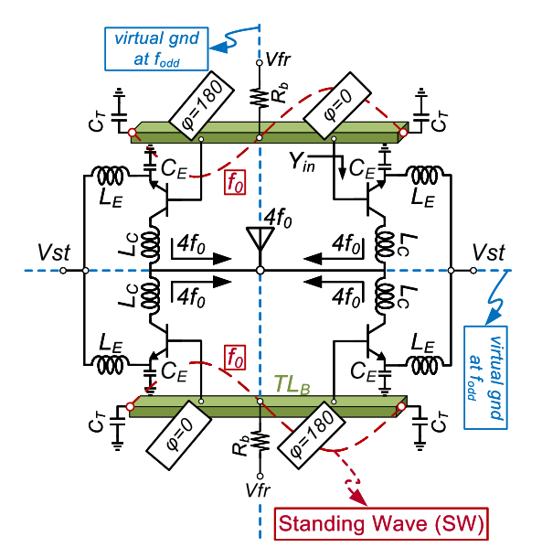
Topology: VCO
VCO
Standing Wave Oscillator [4][13][19]
Modified Cross-Coupled [1][17]
Modified Colpitts [6][8][12]
Others [the rest]
by Hans Herdian, Tokyo Institute of Technology

